Slide 1
Qualifications
for Data Analyst
in California
Aoran Zhang
Yi Meng
Xiaofei Li
University of California Davis

Slide 2


Project Background
1．Data analysis is now applied in everywhere.
2．More and more graduated students are looking for “Data Analyst” posts.
3．Our project play an important role in the posts finding process.

Slide 3
Project Data
1．Professional Job Website-----”Indeed”
2．200 Pages
3．3000 Post Information
4．2445 Data

Slide 4
Skills Requirements
Web
Scrapping
Basic
Requirements
Project Discription
Find URL
Companies’ locations and information
Requirement and Required Skills
Visualization and Statistics Analysis

Slide 5
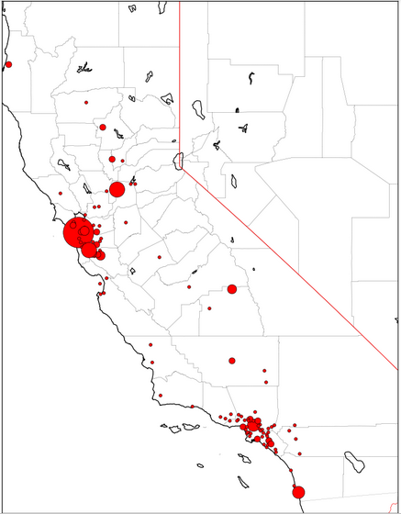
Skills Requirements
Web
Scrapping
Basic
Requirements
SAC
SF
PA
LA
SD

Slide 6
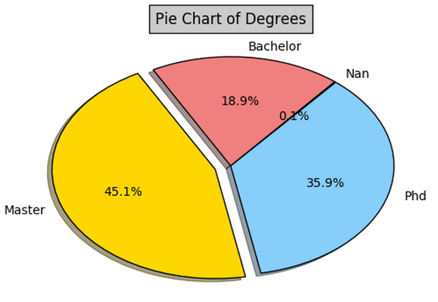
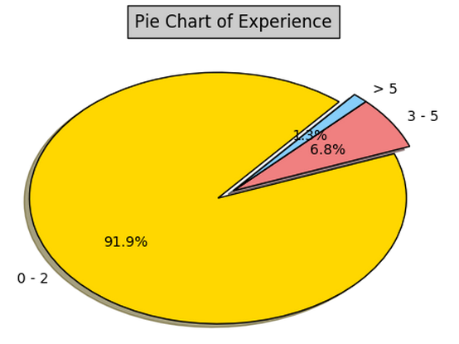
Skills Requirements
Web
Scrapping
Basic
Requirements
Pie Chart of Education Background
Pie Chart of Working Experience

Slide 7

Skills Requirements
Web
Scrapping
Basic
Requirements
Natural Language Processing
Stem
lemmatize
lDF Calculation

Slide 8
Skills Requirements
Web
Scrapping
Basic
Requirements
Word cloud

Slide 9
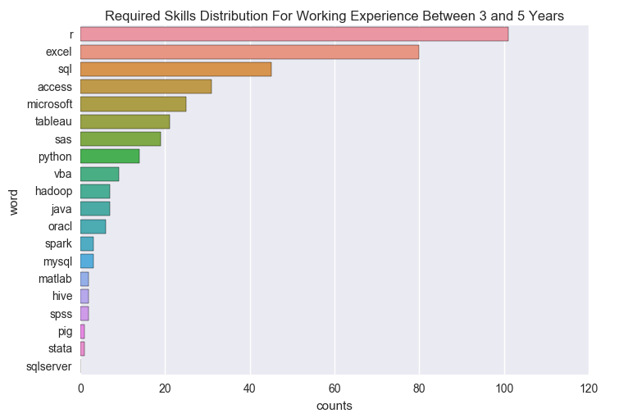
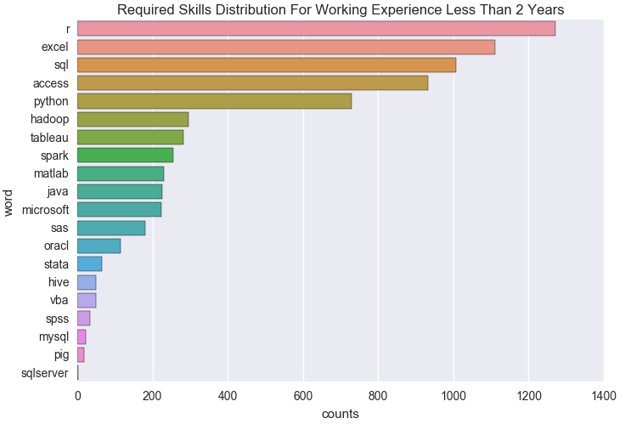
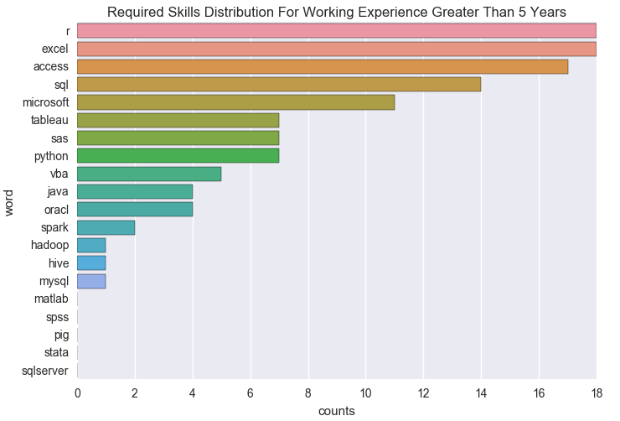
Skills Requirements vs Working Experience
Web
Scrapping

Slide 10
Skills Requirements vs Education Background
Web
Scrapping

Slide 11

Method
Generalization

Slide 12

Method Generalization
Guide the choice of employment place
Key factors to improve competitiveness
Generalize to analyze big data
城市收入水平，建设水平，行业发展前景对毕业生选择就业城市有一定影响

Slide 13
Aoran Zhang Yi Meng Xiaofei Li
Thank you!
University of California, Davis

